Slide 1




Slide 2
Objectives
Detailed Object-Oriented Requirements Definitions
System Processes—A Use Case/Scenario View
Identifying Inputs and Outputs—The System Sequence Diagram
Identifying Object Behavior—The Statechart Diagram
Integrating Object-Oriented Models
Object-Oriented Analysis and Design with the Unified Process

Slide 3
Overview
Refine requirements to threshold of implementation
Apply OOA to use cases and models
Translate process descriptions into working algorithms
Observe that analysis-design boundary is fluid
Object-Oriented Analysis and Design with the Unified Process

Slide 4
Detailed Object-Oriented Requirements Definitions
System requirements captured with OO models
“Divide and conquer” strategy toward complexity
Two subsets of OO modeling approach
  Use case driven extending four specific models
    Use case diagrams, use case descriptions, activity diagrams, system sequence diagrams
  Object driven extending statechart diagram
Object-Oriented Analysis and Design with the Unified Process

Slide 5
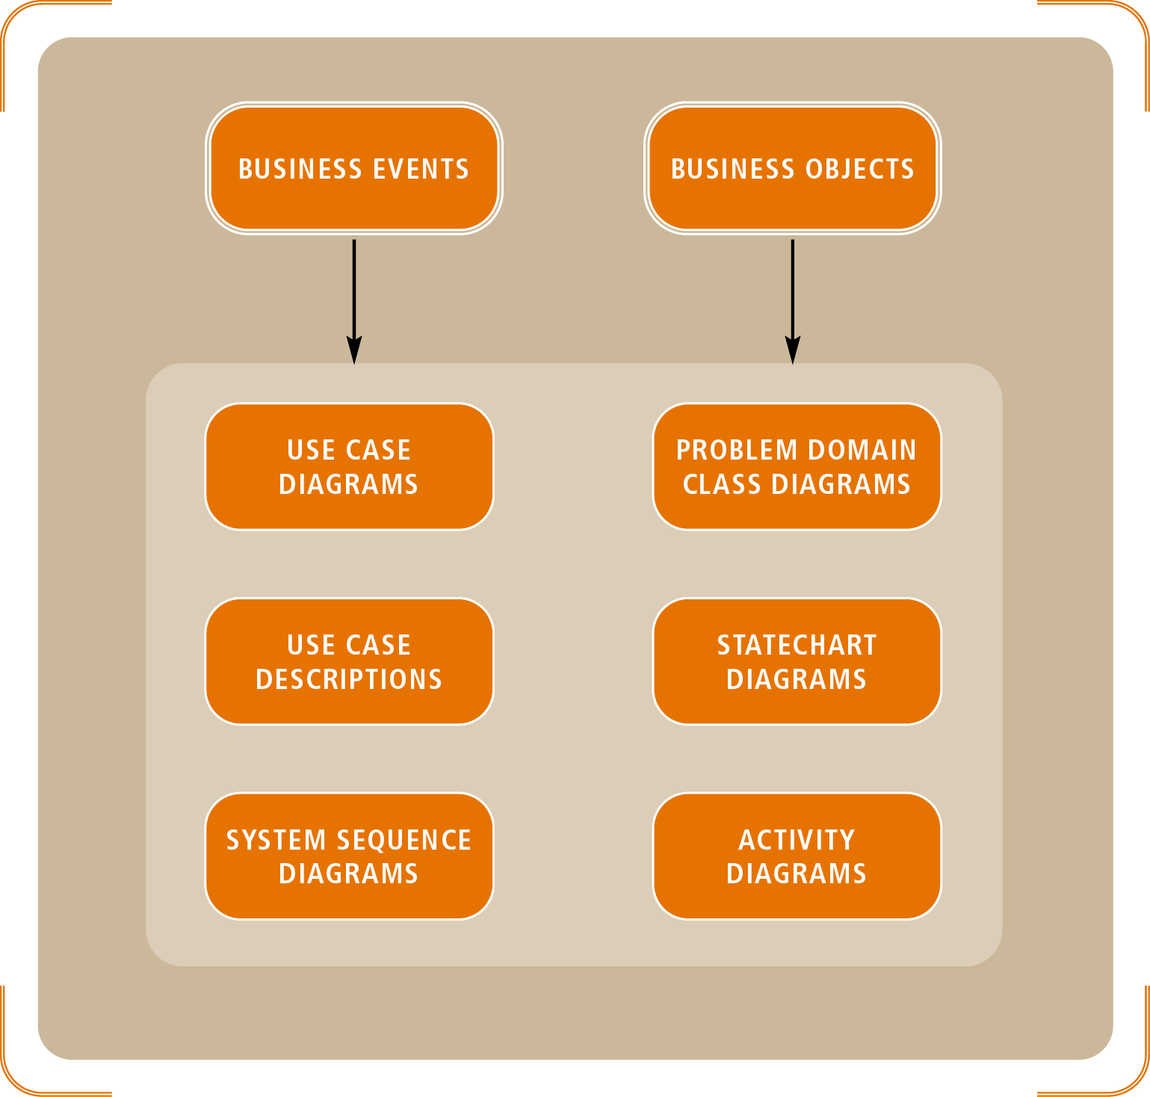
Figure 6-1
Requirements Diagrams With UML Models
Object-Oriented Analysis and Design with the Unified Process

Slide 6
Detailed Object-Oriented Requirements Definitions (continued)
Use case diagram: table of contents for business events
System sequence diagrams (SSDs)
  Define and order sequence of inputs and outputs
  Information flows referred to as messages
Class diagrams
  Identify real-world “things”
  Determine the structure of the programming classes
Statechart diagram describes collection of object states
Object-Oriented Analysis and Design with the Unified Process

Slide 7
System Processes—A Use Case/Scenario View
Define use cases into two tiers:
  Overview level derived from:
    Event table and use case diagrams
  Detailed level derived from combination of:
    Use case description
    Activity diagram
    Sequence diagram
Object-Oriented Analysis and Design with the Unified Process

Slide 8
Use Cases and Actors
Source
  Person or thing initiating the business event
  Must be external to the system
Actor
  Person or thing that touches the system
  Lies outside of automation boundary
Identifying actors at the right level of detail
  Assume actors (even non-human types) have hands
  Use case is a goal that the actor wants to achieve
Object-Oriented Analysis and Design with the Unified Process

Slide 9
The Use Case Diagram
Notation for use case diagrams
  Simple stick figure represents an actor
  Actor’s hands indicate direct system access
  Use case itself symbolized by an oval
  Connecting lines match actors to use cases
Actors may also be other system interfaces
  May be represented with stick figure or rectangle
Object-Oriented Analysis and Design with the Unified Process

Slide 10
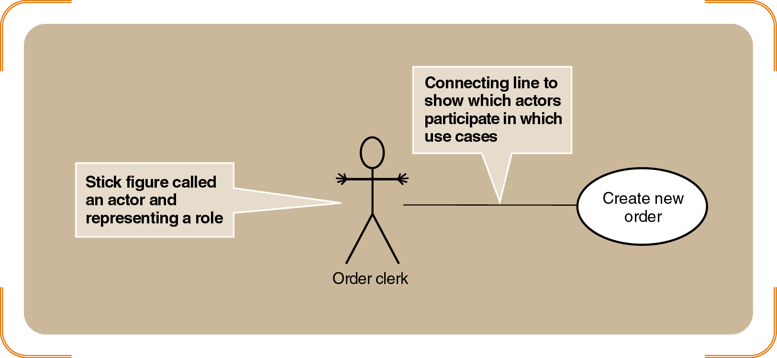
Figure 6-2
A Simple Use Case with an Actor
Object-Oriented Analysis and Design with the Unified Process

Slide 11
Automation Boundary and Organization
Expand use case diagrams with other actors and use cases
Relationship line: allows each actor to interact with each use case
Automation boundary
  Line drawn around the entire set of use cases
  Defines interface between actors and computer system
Object-Oriented Analysis and Design with the Unified Process

Slide 12
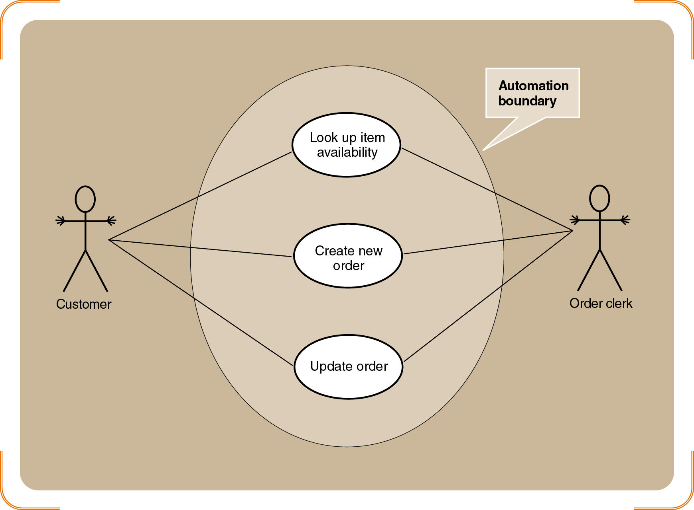
Figure 6-3
A Use Case Diagram of the Order-Entry Subsystem for RMO, Showing a System Boundary
Object-Oriented Analysis and Design with the Unified Process

Slide 13
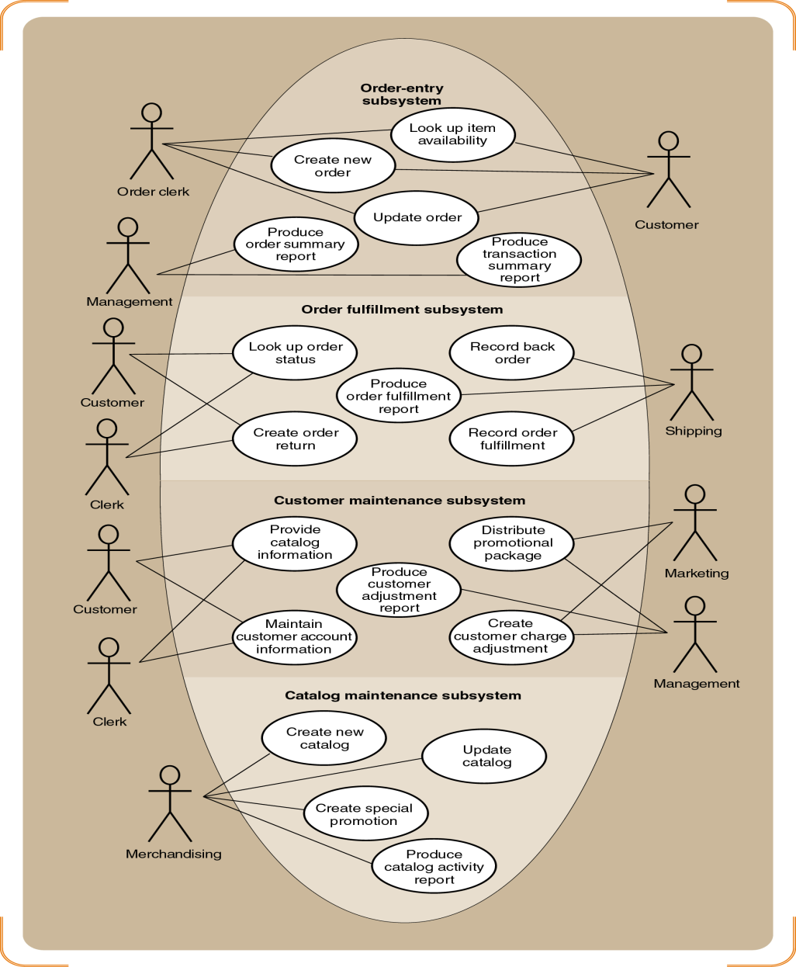
Figure 6-4
A Use Case Diagram of the Customer Support System (by Subsystem)
Object-Oriented Analysis and Design with the Unified Process

Slide 14
« Includes » Relationships
«includes» or «uses» relationship
  Use case calling services of common subroutine
  Common subroutine itself becomes additional use case
Examples: “Validate customer account” and “Look Up Item Availability”
Notation
  Relationship denoted by connecting line with arrow
  Direction of the arrow indicates major/minor cases
Object-Oriented Analysis and Design with the Unified Process

Slide 15
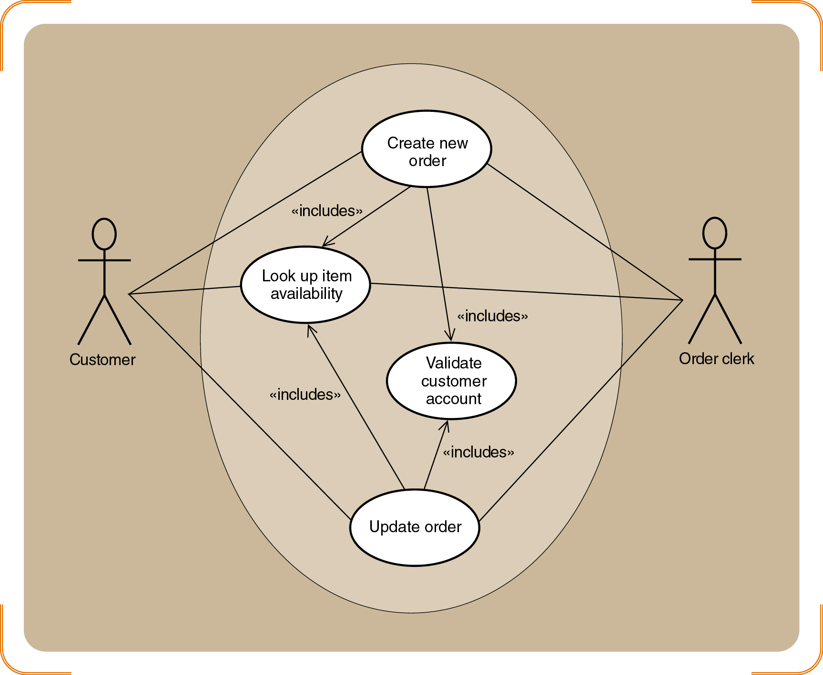
Figure 6-6
An Example of the Order-entry Subsystem With «Includes» Use Cases
Object-Oriented Analysis and Design with the Unified Process

Slide 16
Developing a Use Case Diagram
Two ways to identify additional use cases
  Divide one large use case into two
  Define another use case based on a common subroutine
Distinguish between temporal and state events
Iterative process translates business events to use cases
  [1] Identify the actors and roles for each use case
  [2] Extract system response to business events
Data of system stabilizes after completion of the goal
Object-Oriented Analysis and Design with the Unified Process

Slide 17
Use Case Detailed Descriptions
Use cases have internal complexity
  Sequence of steps to execute business process
  Several variations may exist within single use case
    Valid variation known as scenario
  Example: “Create new order” varies from phone to Internet order
Work with variety of diagrams and descriptions for each use case
Object-Oriented Analysis and Design with the Unified Process

Slide 18
Use Case Detailed Descriptions (continued)
Use case descriptions written at (3) levels of detail
  Brief description
    Summary statement conjoined to activity diagram
  Intermediate description
    Expands brief description with internal flow of activities
  Fully Developed Description
    Expands intermediate description for richer view
Object-Oriented Analysis and Design with the Unified Process

Slide 19
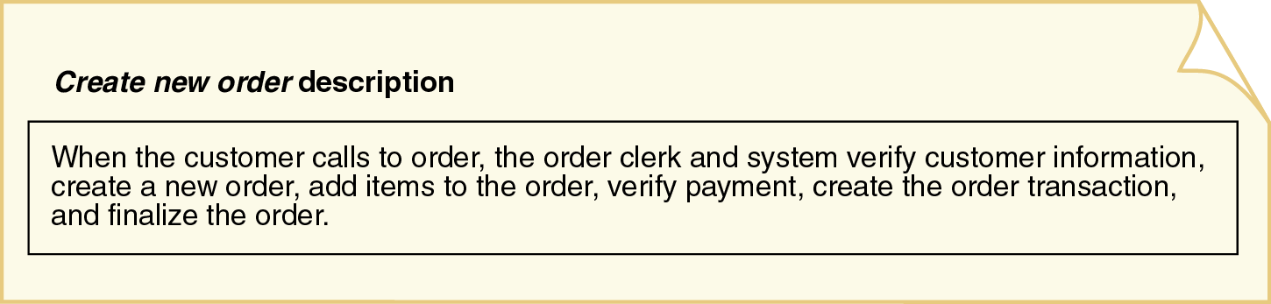
Figure 6-7
Brief Description of Create New Order Use Case
Object-Oriented Analysis and Design with the Unified Process

Slide 20
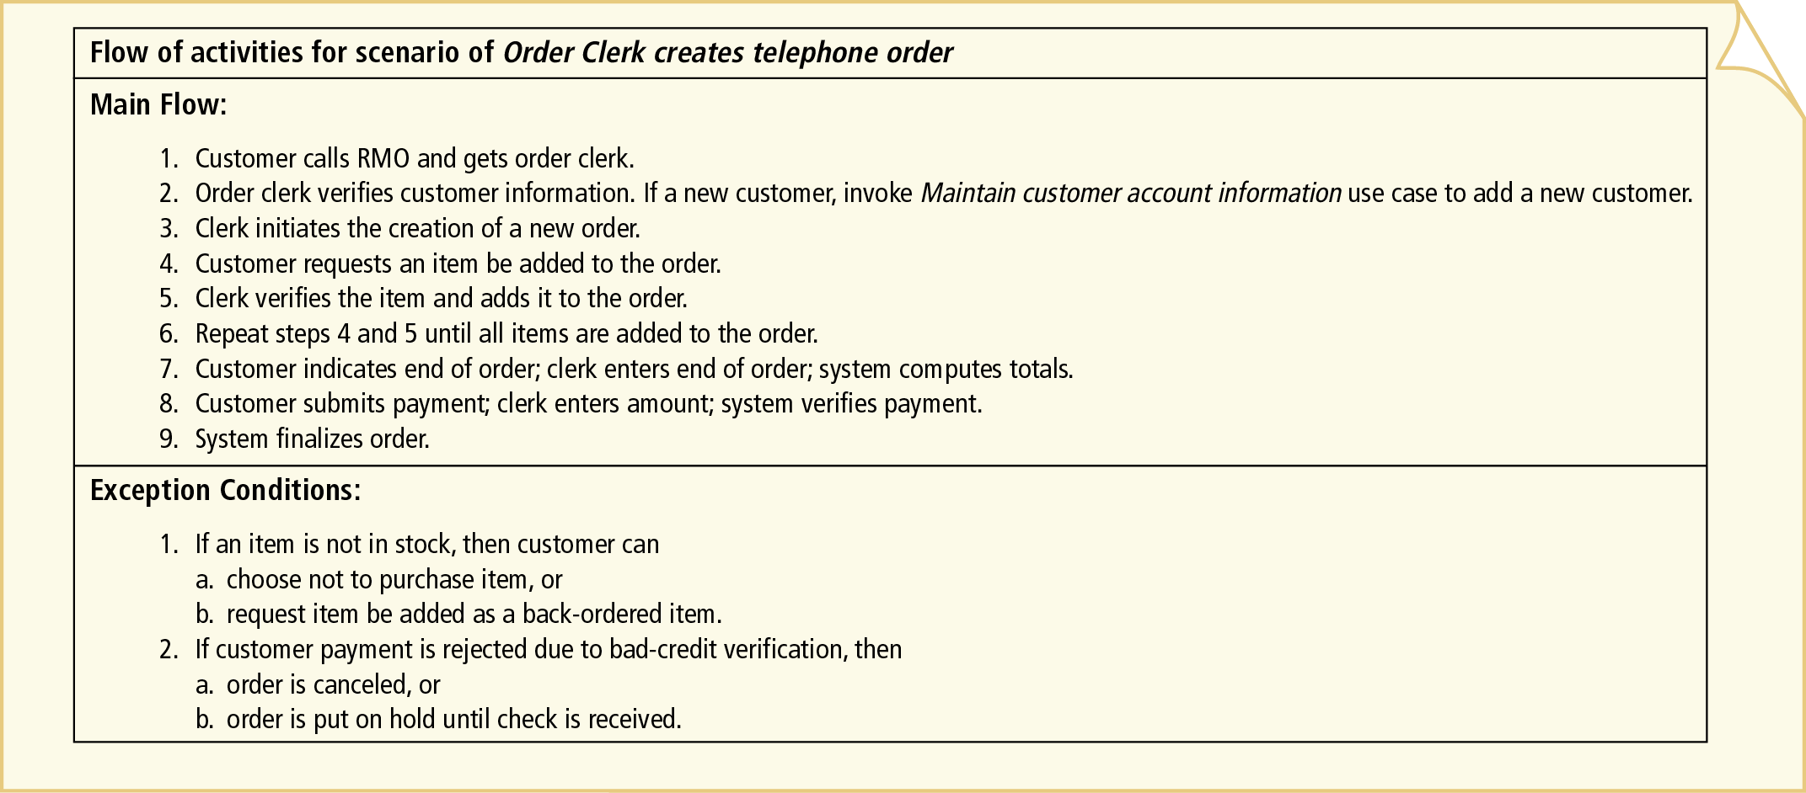
Figure 6-8
Intermediate Description of Telephone Order Scenario for Create New Order Use Case
Object-Oriented Analysis and Design with the Unified Process

Slide 21
Use Case Detailed Descriptions (continued)
Fully developed use case description
  Superset of intermediate and brief descriptions
  Consists of eleven compartments
  User, actor, stakeholder, EBP, and conditions identified
Activity Diagram Description
  Document the workflows of business processes
  Document flow of activities for use case scenarios
  Form basis of system sequence diagrams (SSDs)
Object-Oriented Analysis and Design with the Unified Process

Slide 22
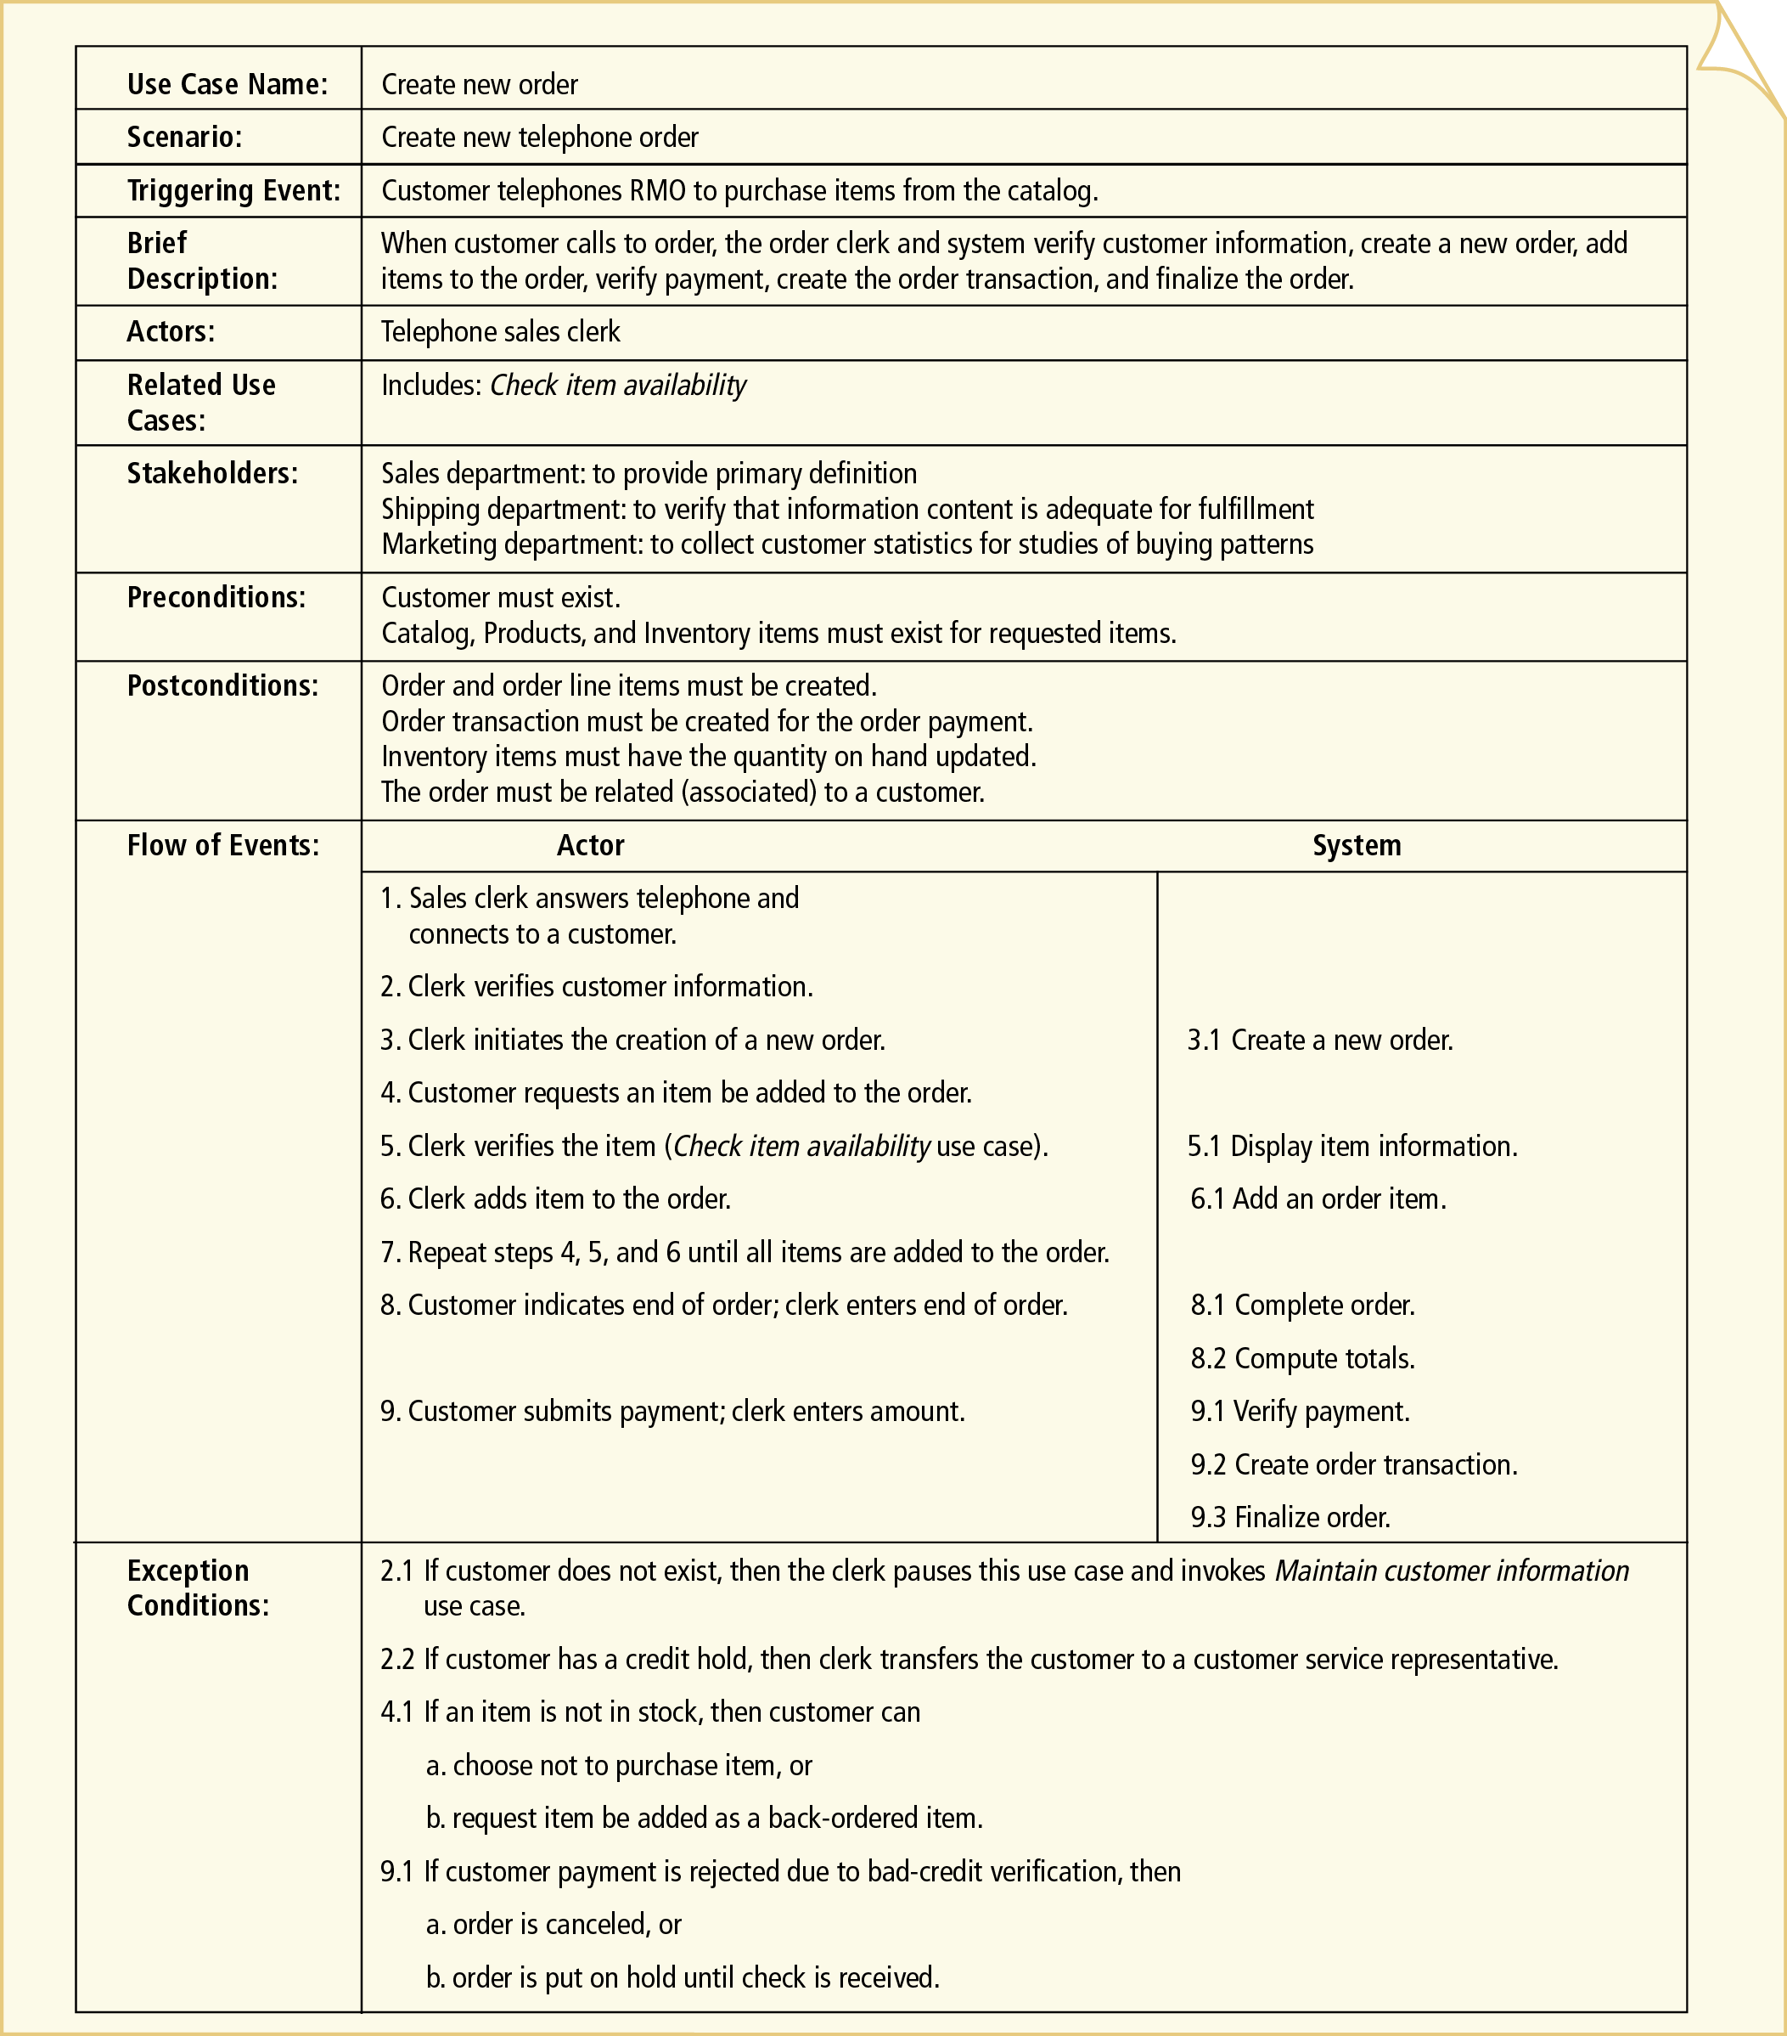
Figure 6-10
Fully Developed Description of Telephone Order Scenario for Create New Order Use Case
Object-Oriented Analysis and Design with the Unified Process

Slide 23
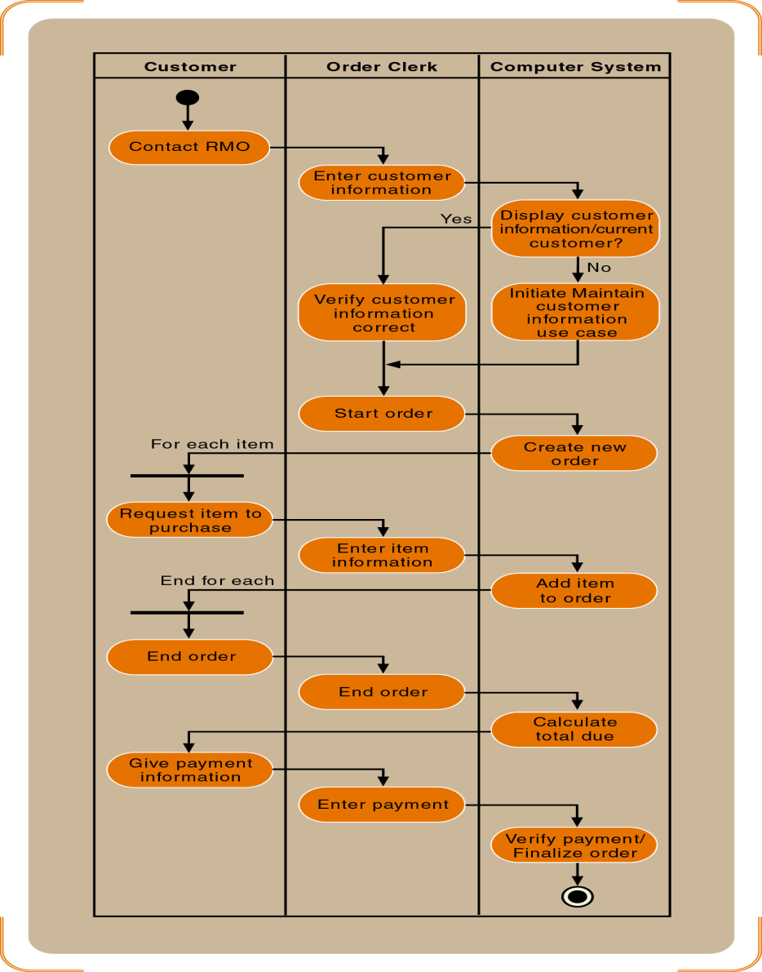
Figure 6-12
Activity Diagram of the Telephone Order Scenario
Object-Oriented Analysis and Design with the Unified Process

Slide 24
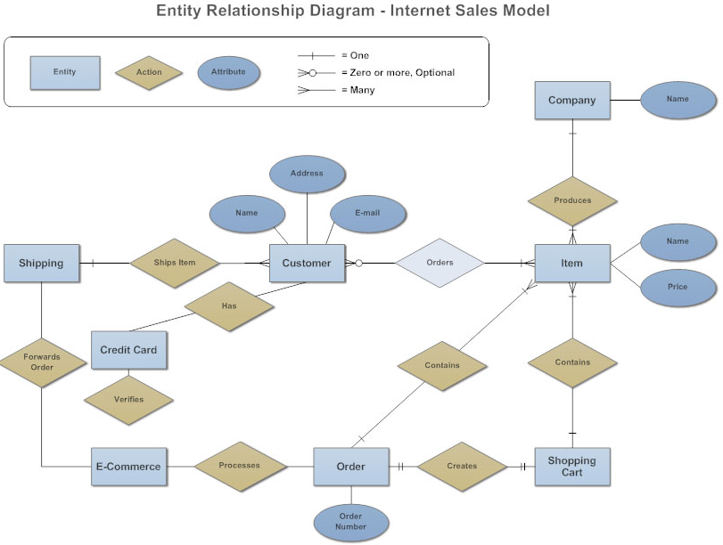
Object-Oriented Analysis and Design with the Unified Process

Slide 25
Identifying Inputs and Outputs—the System Sequence Diagram
System sequence diagram (SSD)
  Describes flow of information
  Identifies interaction between actors and system
  Message oriented
Object-Oriented Analysis and Design with the Unified Process

Slide 26
SSD Notation
Actor “interacts” with the system via input/output
SSDs use object notation
  Box (rectangle) refers to individual object
  Name of the object underlined
  Messages sent/received by objects, not classes
Lifeline
  Extension of object or actor for duration of the SSD
  Indicates sequence of the messages sent/received
Object-Oriented Analysis and Design with the Unified Process

Slide 27
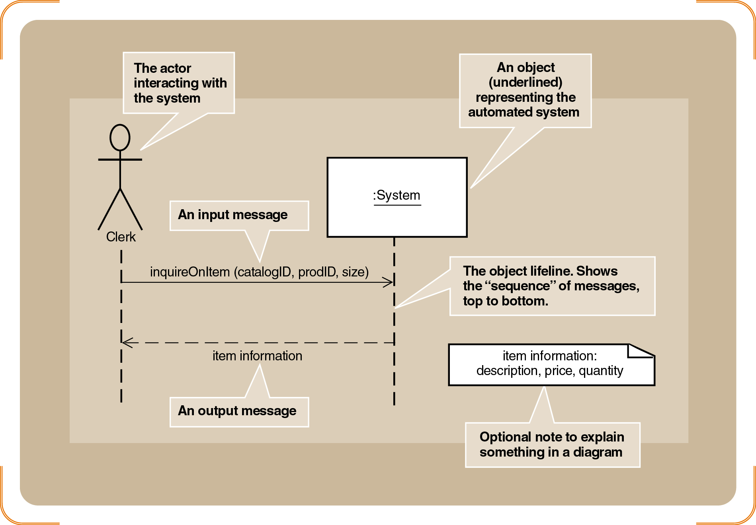
Figure 6-14
Sample System Sequence Diagram
Object-Oriented Analysis and Design with the Unified Process

Slide 28
SSD Notation (continued)
Message syntax can take several forms
  Depends on send/return direction
Message semantics: actions (like commands) invoked on destination object
Complete message notation:*[true/false condition] return-value := message-name (parameter-list)
Object-Oriented Analysis and Design with the Unified Process

Slide 29
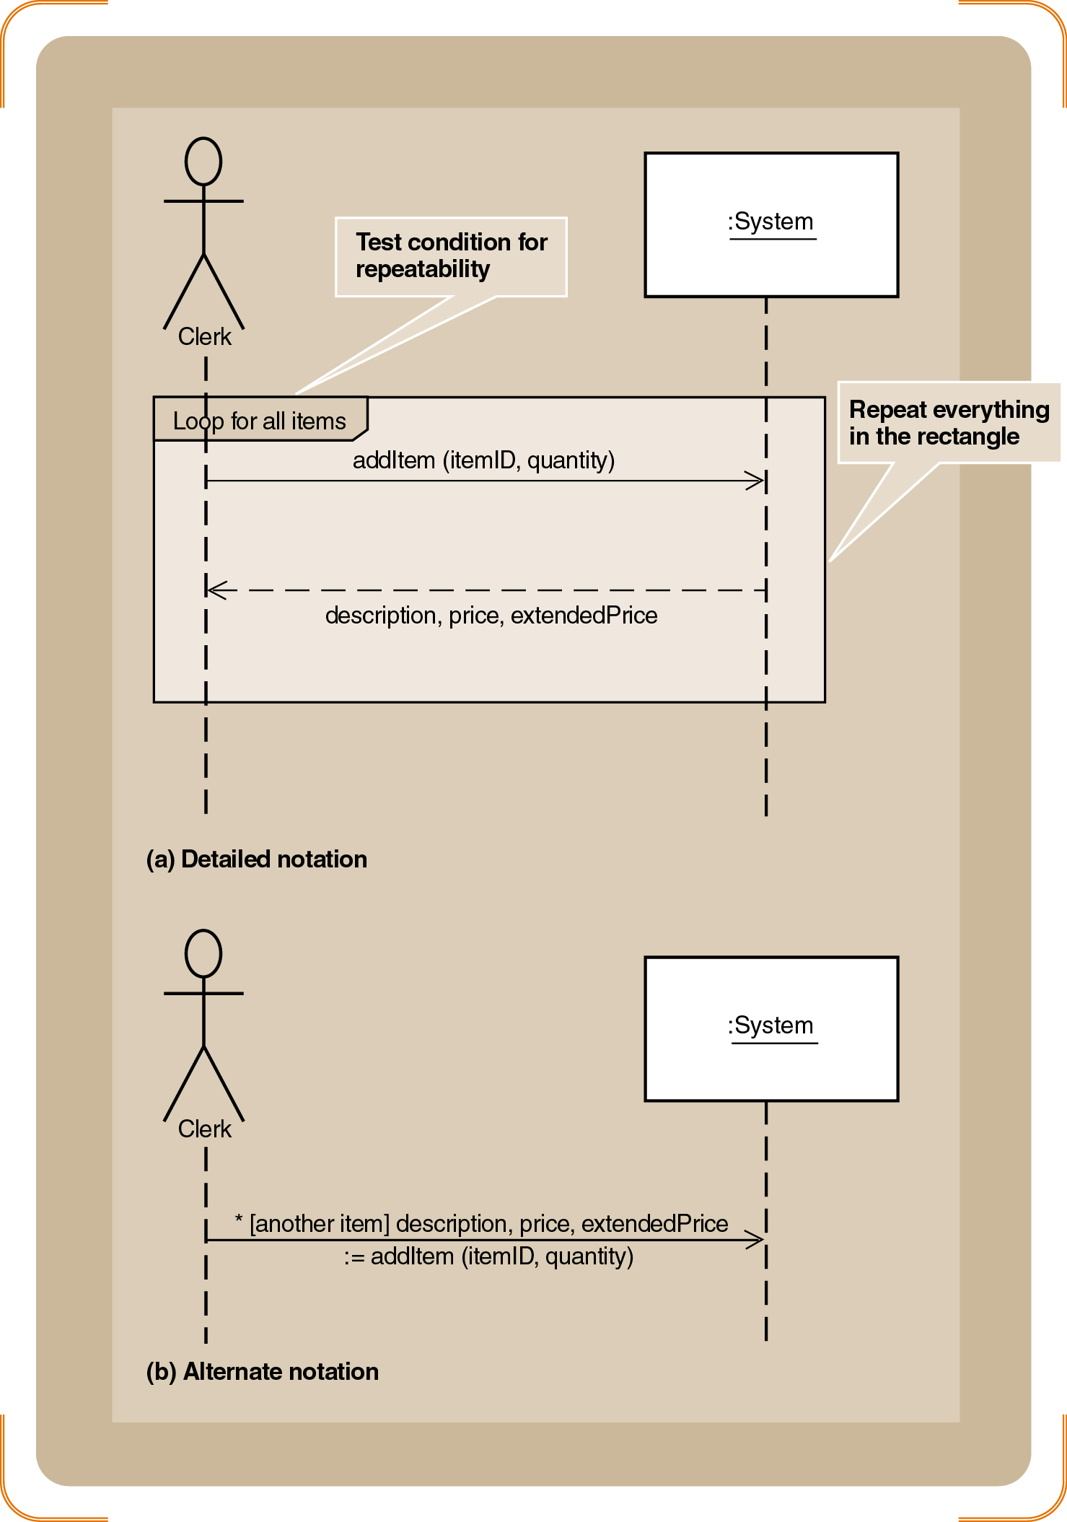
Figure 6-15
Repeating Message (A) Detailed Notation (B) Alternate Notation
Object-Oriented Analysis and Design with the Unified Process

Slide 30
Developing a System Sequence Diagram
Begin with detailed description of use case
  Fully developed form
  Activity diagrams
(4) step process for turning activity diagram into SSD
  [1] Identify the input messages
  [2] Describe messages from external actor to system
  [3] Identify/apply special conditions to input messages
  [4] Identify and add the output return messages
Object-Oriented Analysis and Design with the Unified Process

Slide 31
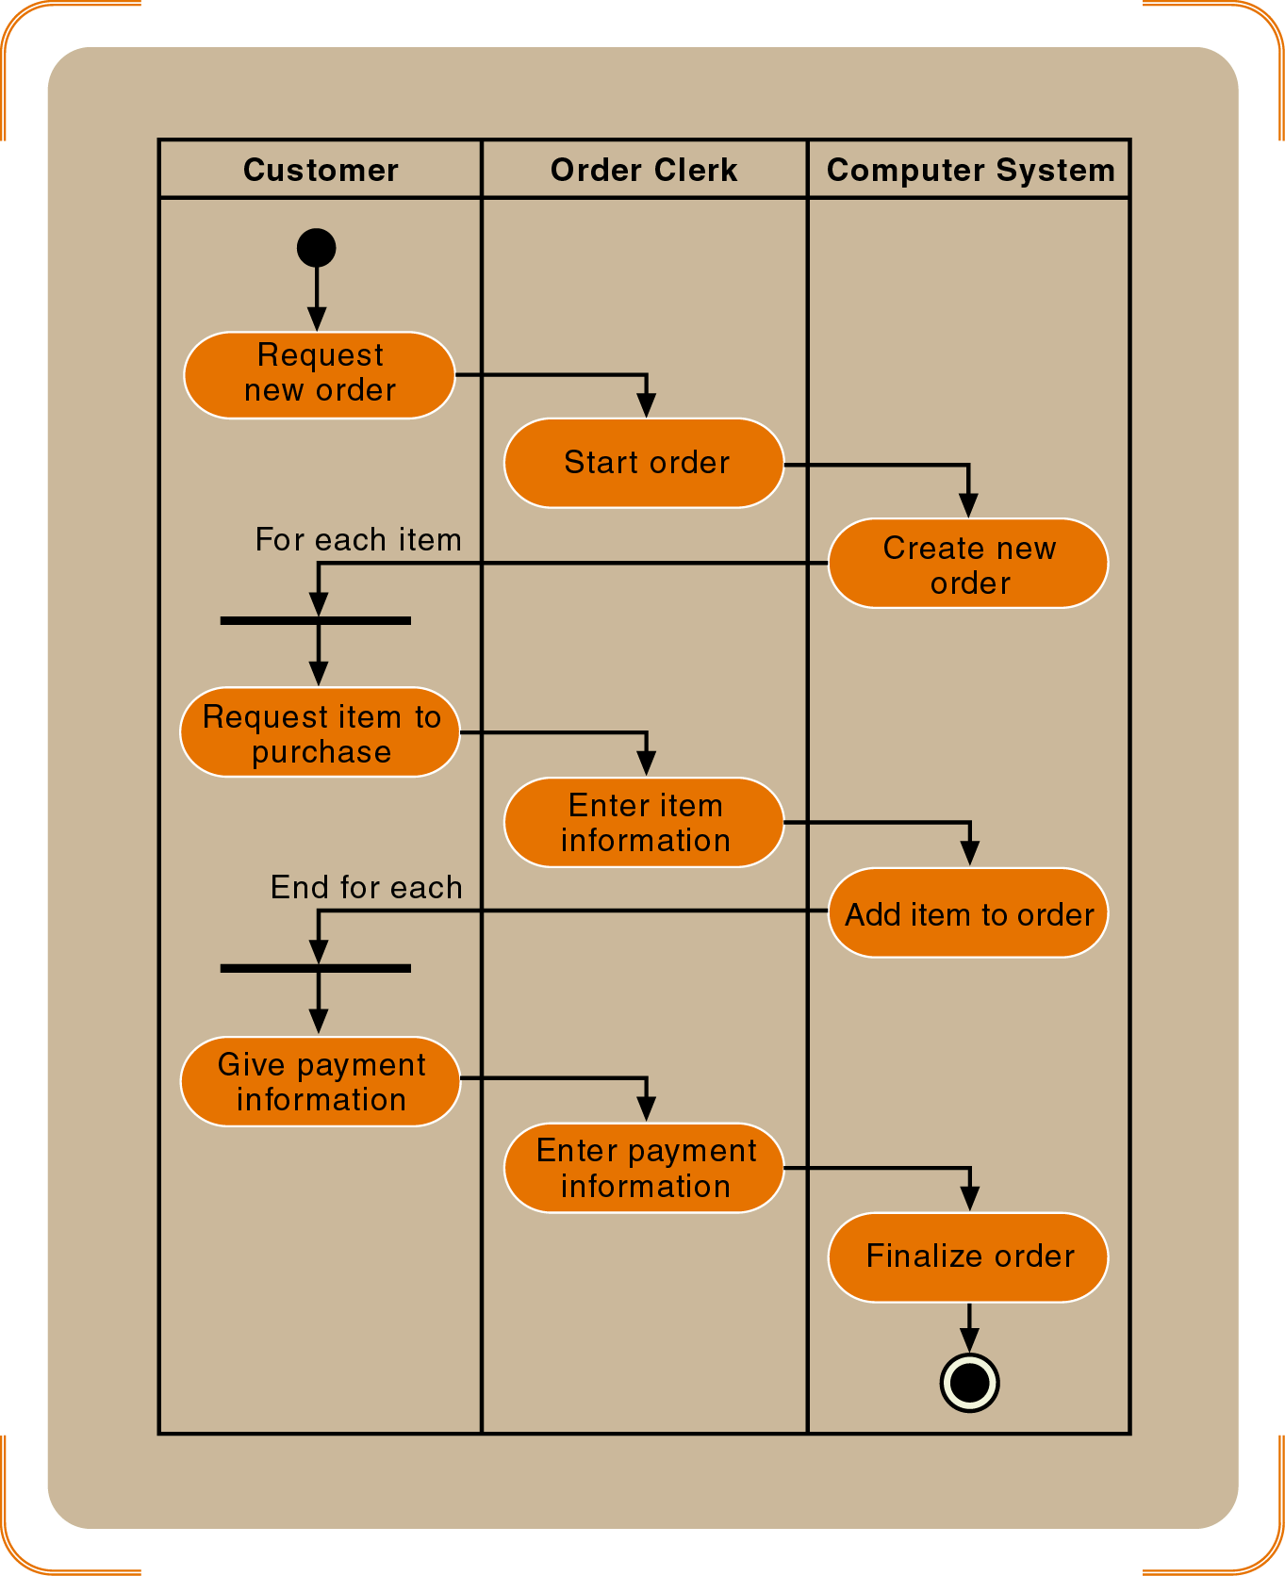
Figure 6-16
A Simplified Diagram of the Telephone Order Scenario
Object-Oriented Analysis and Design with the Unified Process

Slide 32
Developing a System Sequence Diagram (continued)
Names of messages reflect services performed
Important principle for identifying data parameters
  Base the list on the class diagram
  Attributes from the classes listed as parameters
Iteratively define input/output parameters around workflows
Objective: discovery and understanding
Object-Oriented Analysis and Design with the Unified Process

Slide 33
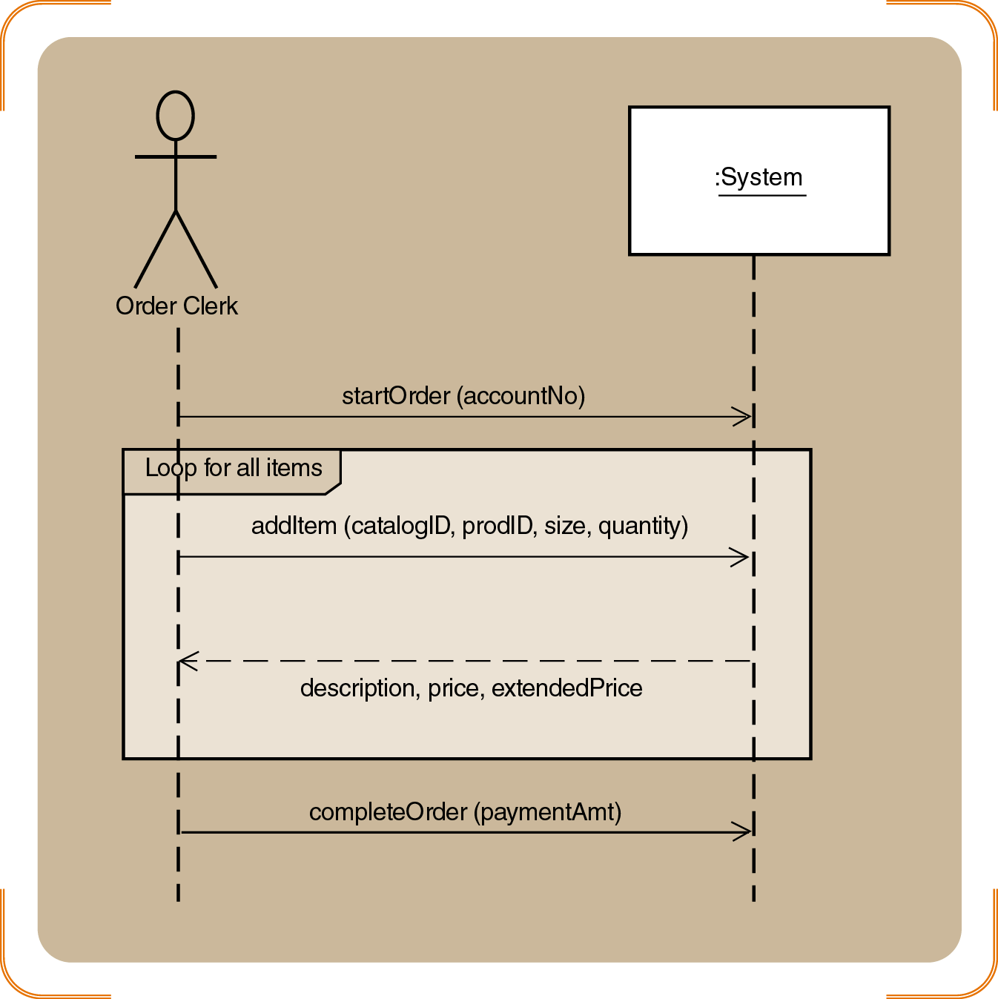
Figure 6-17
An SSD of the Simplified Telephone Order Scenario for the Create New Order Use Case
Object-Oriented Analysis and Design with the Unified Process

Slide 34
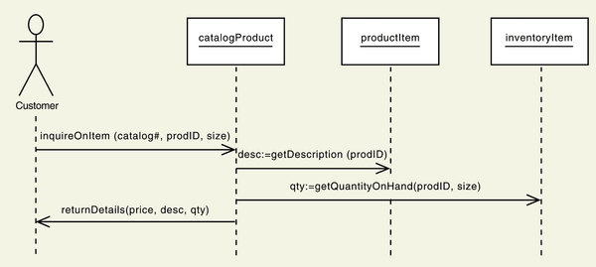
Sequence Diagram for
Look Up Item Availability
Figure 7-16
Object-Oriented Analysis and Design with the Unified Process

Slide 35
Identifying the Object Behavior⎯the Statechart Diagram
A state in a statechart similar to status condition
  Spans many business events
  Developed for complex problem domain classes
Statechart diagram
  Composed of ovals representing status of object
  Arrows represent transitions
Object-Oriented Analysis and Design with the Unified Process

Slide 36
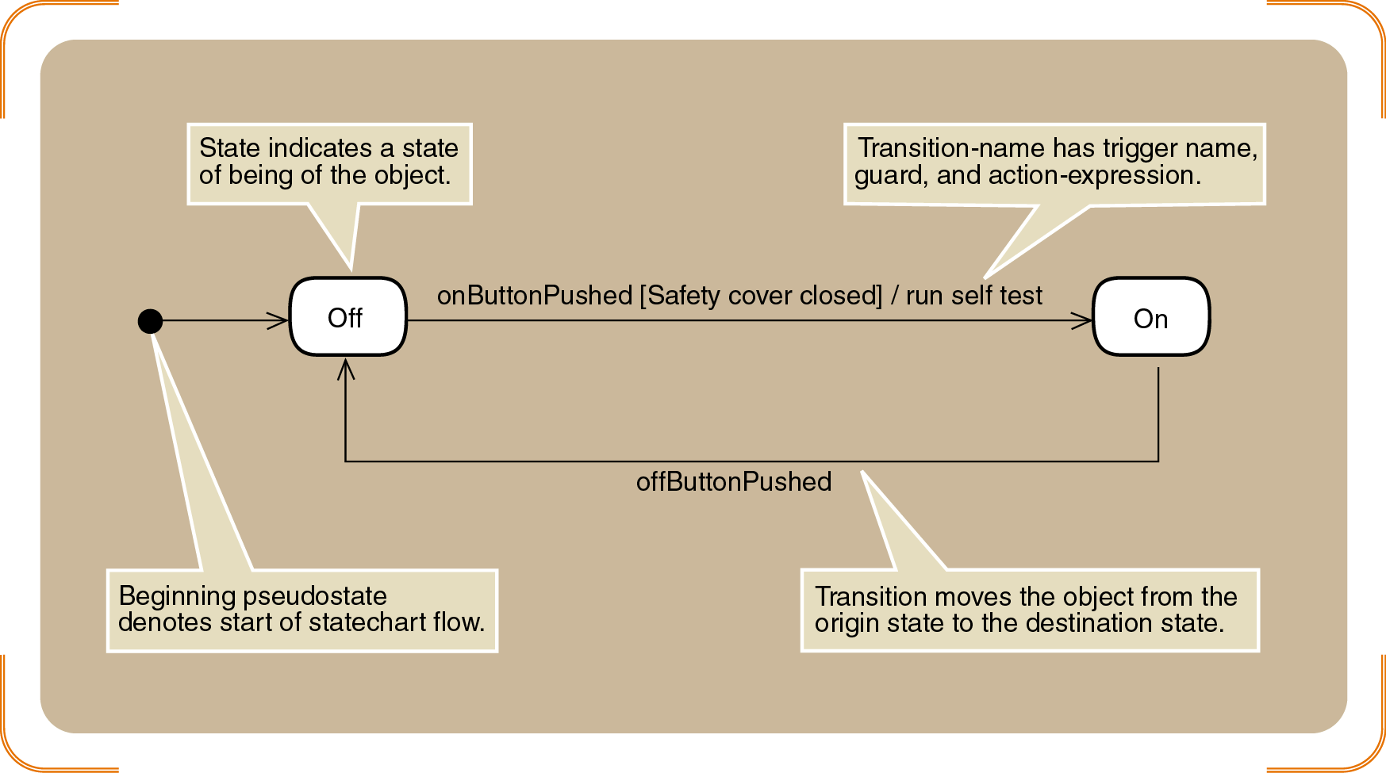
Figure 6-19
Simple Statechart for a Printer
Object-Oriented Analysis and Design with the Unified Process

Slide 37
Identifying the Object Behavior⎯the Statechart Diagram (continued)
Guidelines to help identify states
  Check naming convention for status conditions
  Simple states reflect simple conditions such as “On”
  Complex states labeled with gerunds or verb phrases
    Example: “Being shipped”
  Active states usually not labeled with nouns
  Describe only states of being of the object itself
  Status conditions reported to management/customers
    Example: “Shipped”
Object-Oriented Analysis and Design with the Unified Process

Slide 38
Nested States And Concurrency
Concurrency: condition of being in more than one state at a time
Two modes of representation
  Use synchronization bars and concurrent paths
  Nest low-level states inside higher-level states
Higher-level states also called composite states
  Complex structure of sets of states and transitions
  Represent a higher level of abstraction
Object-Oriented Analysis and Design with the Unified Process

Slide 39
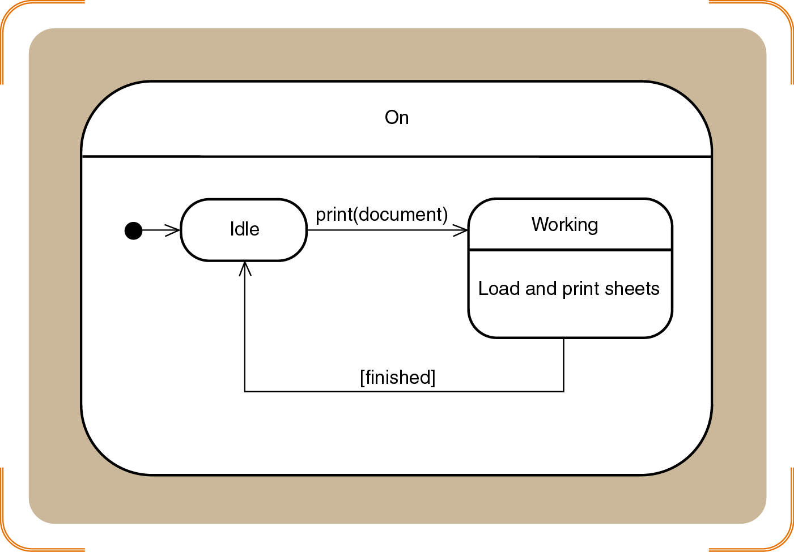
Figure 6-20
Sample Composite States for the Printer Object
Object-Oriented Analysis and Design with the Unified Process

Slide 40
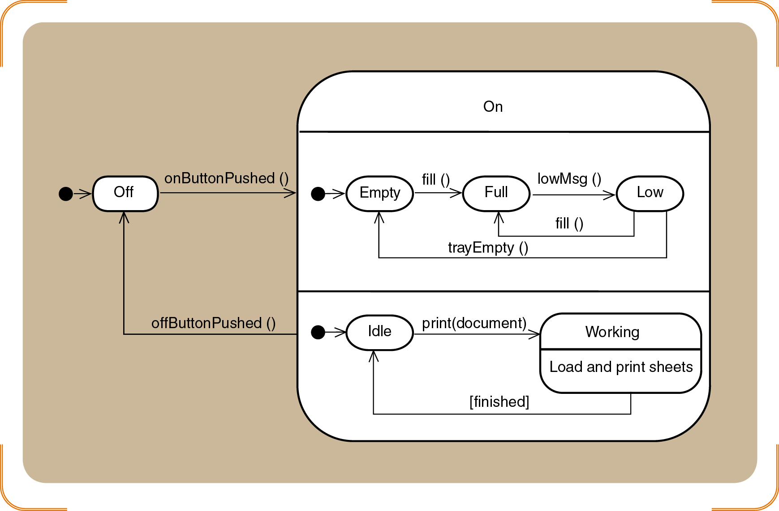
Figure 6-21
Concurrent Paths for the Printer in the On State
Object-Oriented Analysis and Design with the Unified Process

Slide 41
Rules for Developing Statecharts
[1] Select the classes that will require statecharts
[2] List all the status conditions for each group
[3] Specify transitions that cause object to leave the identified state
[4] Sequence state-transition combinations in correct order
Object-Oriented Analysis and Design with the Unified Process

Slide 42
Rules for Developing Statecharts (continued)
[5] Identify concurrent paths.
[6] Look for additional transitions
[7] Expand each transition as appropriate
[8] Review and test each statechart
Object-Oriented Analysis and Design with the Unified Process

Slide 43
Developing RMO Statecharts
Review the domain class diagram
Select classes with status conditions that need to be tracked
Candidates: Order, OrderItem, InventoryItem, Shipment, Customer
Choose Order and OrderItem
  Simplicity
  Location in the class hierarchy
Object-Oriented Analysis and Design with the Unified Process

Slide 44
Developing The Order Item State Chart
Identify possible status conditions of interest
  “Ready to be shipped”
  “On back order”
  “Shipped”
Continue developing statechart according to eight rules
Object-Oriented Analysis and Design with the Unified Process

Slide 45
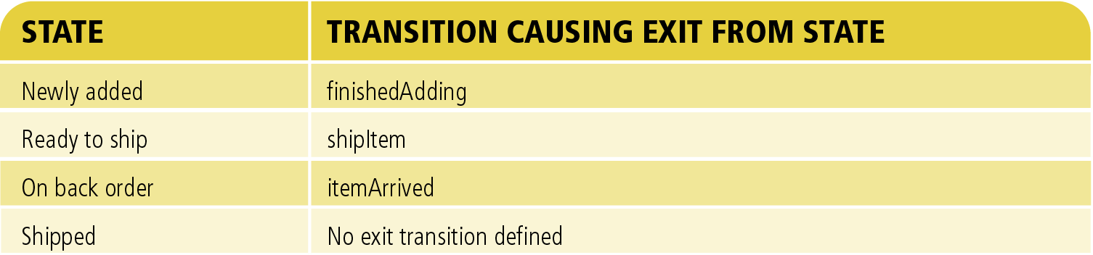
Figure 6-22
States and Exit Transitions for Orderitem
Object-Oriented Analysis and Design with the Unified Process

Slide 46
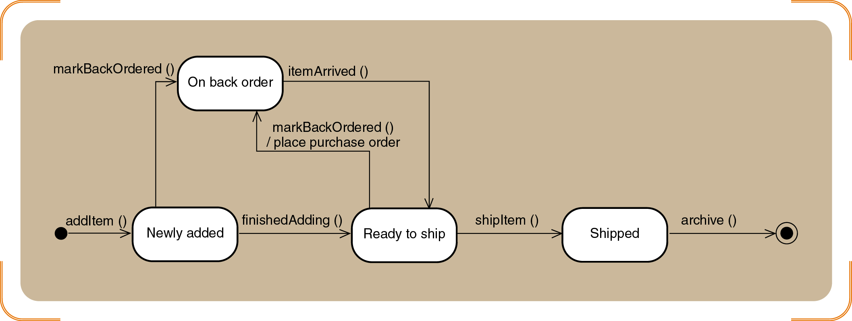
Figure 6-24
Final Statechart for Orderitem
Object-Oriented Analysis and Design with the Unified Process

Slide 47
Developing the Order State Chart
States mirror the life cycle of an order
Application of rules leads to greater complexity
  Concurrent states
  New transitions
Benefits of developing a statechart for an object
  Captures and clarifies business rules
  Gain true understanding of system requirements
Object-Oriented Analysis and Design with the Unified Process

Slide 48
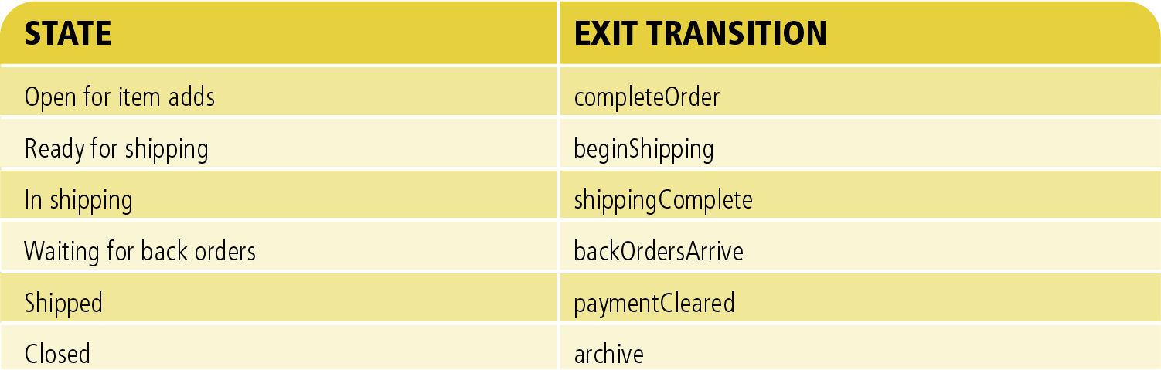
Figure 6-25
States and Exit Transitions for Order
Object-Oriented Analysis and Design with the Unified Process

Slide 49
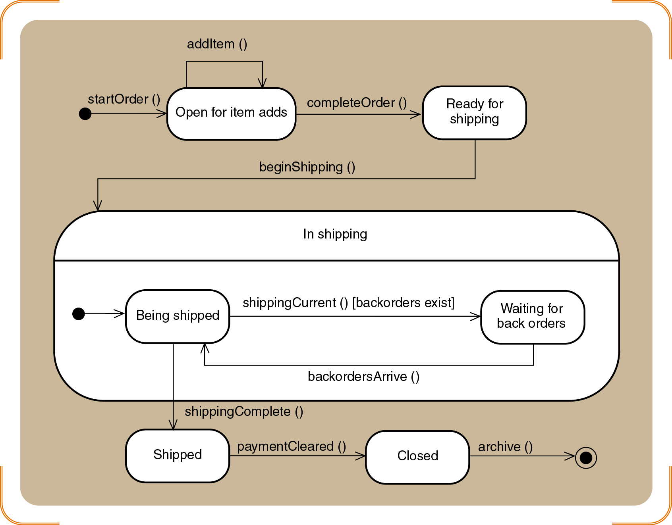
Figure 6-27
Second-cut Statechart for Order
Object-Oriented Analysis and Design with the Unified Process

Slide 50
Integrating Object-Oriented Models
Primary (or source) models
  Use case diagram
  Problem domain class diagram
CRUD analysis validates model completeness
Construction of one model depends on another
Models capturing processes of new system
  Use case diagram and models to lower left
Models capturing information about classes
  Class diagrams and dependencies
Object-Oriented Analysis and Design with the Unified Process

Slide 51
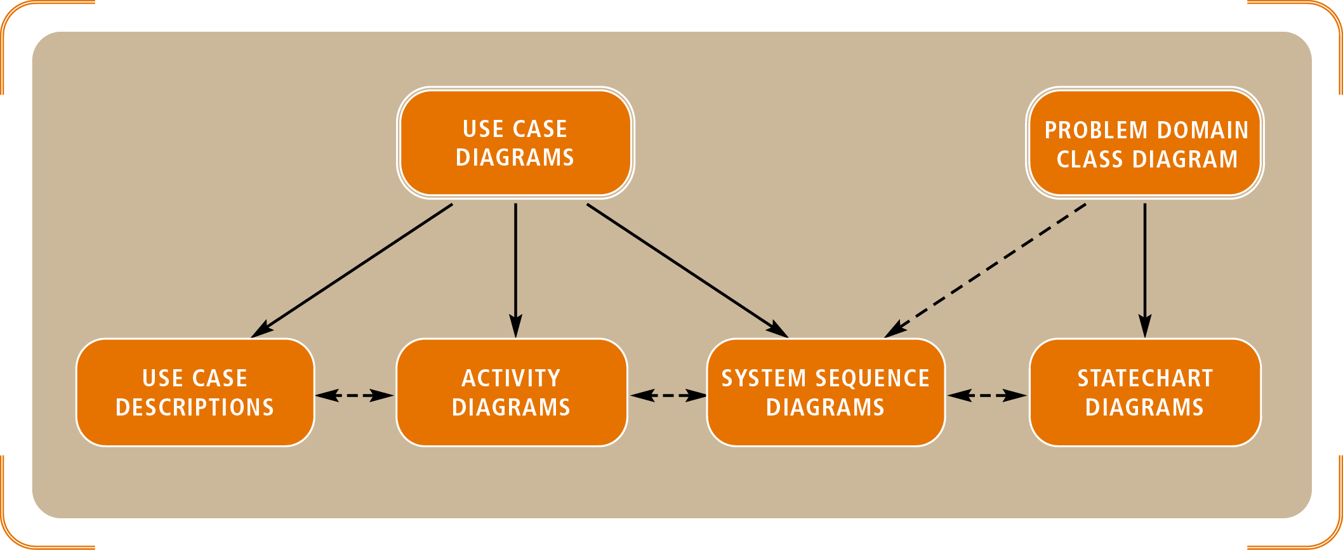
Figure 6-28
Relationships among OO Requirements Models
Object-Oriented Analysis and Design with the Unified Process

Slide 52
Summary
OOA family of models documents users’ needs and defines system requirements
Use case detailed models (descriptive or activity)
Sequence diagrams (SSDs)
Domain model class diagrams
Statechart diagrams
Object-Oriented Analysis and Design with the Unified Process

Slide 53
Summary (continued)
Use case: single system function responding to an event
Actors: human users or system interfaces that initiate system response
System function decomposed into workflows
SSDs, domain models, statecharts emulate routines and object interaction
Software engineering terms signal transition into design phase
Object-Oriented Analysis and Design with the Unified Process

